Slide 1
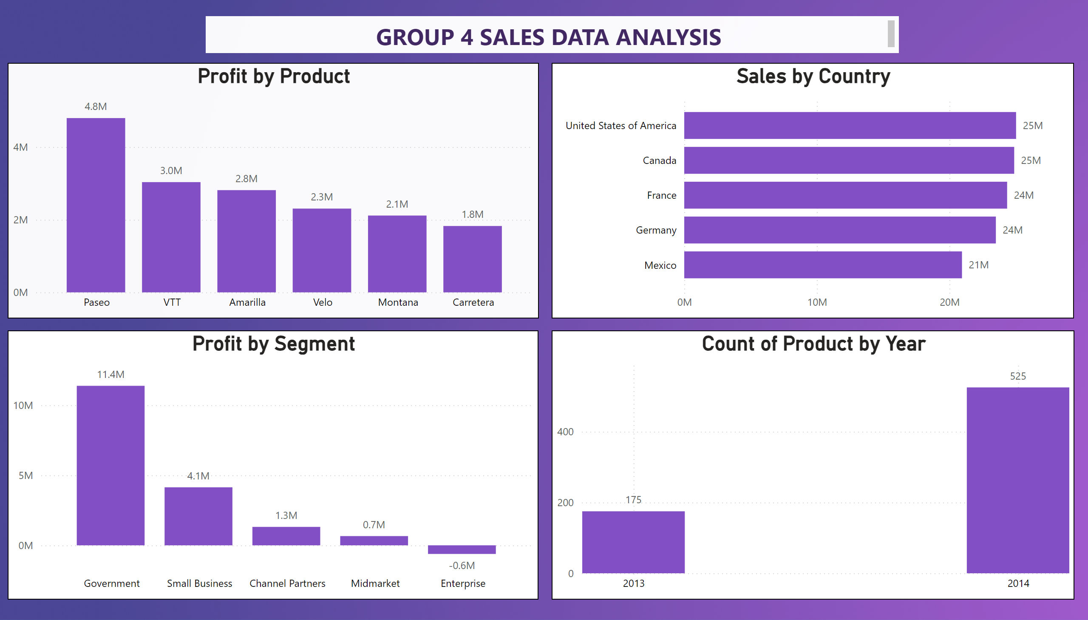
Page 1
Notes:
textbox
No alt text provided
Profit by Product
No alt text provided
Sales by Country
No alt text provided
Profit by Segment
No alt text provided
columnChart
No alt text provided

Slide 2
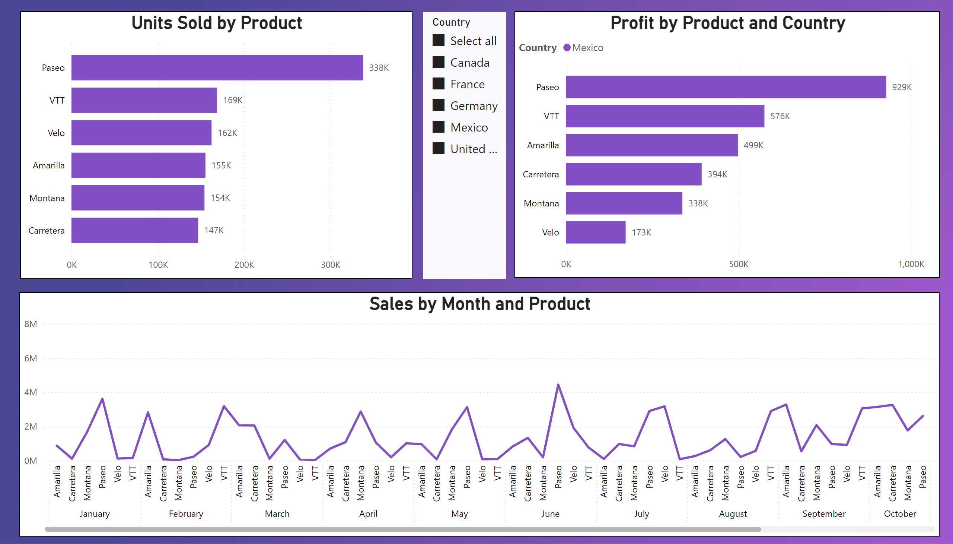
Page 2
Notes:
Units Sold by Product
No alt text provided
Sales by Month and Product
No alt text provided
Profit by Product and Country
No alt text provided
slicer
No alt text provided

Slide 3
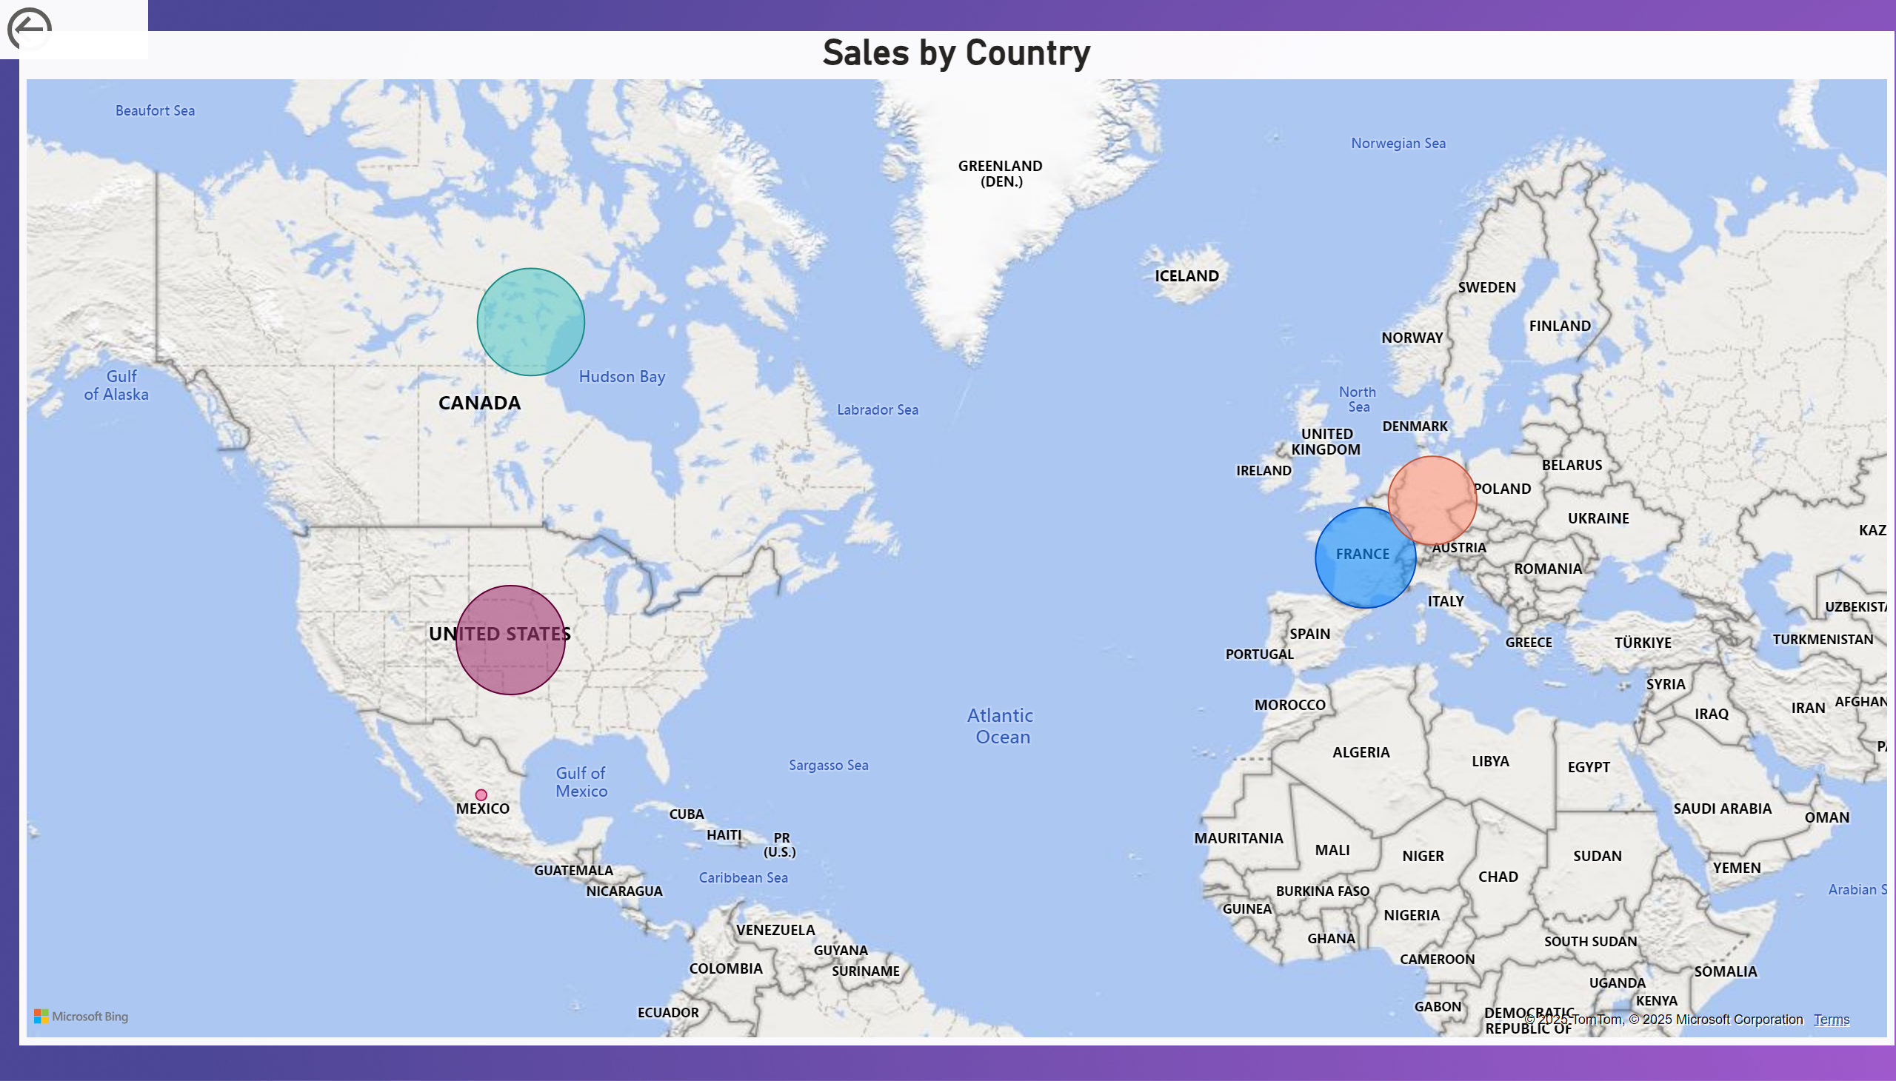
Page 3
Notes:
actionButton
No alt text provided
Sales by Country
No alt text provided

Slide 4
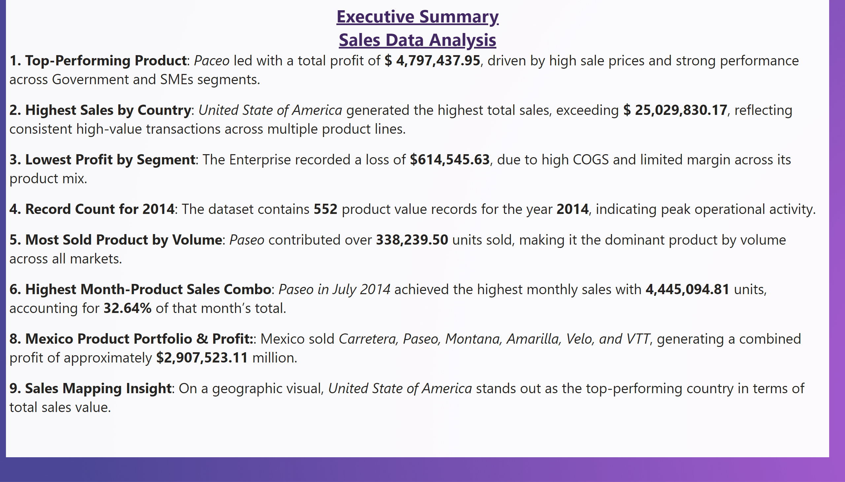
Page 4
Notes:
textbox
No alt text provided

